Slide 1
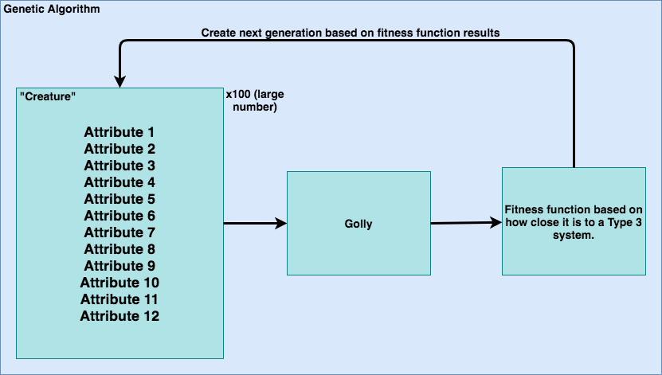
Notes:
Attributes correspond to rule set
Any large number of creatures
“Natural selection” and “mutation” functions to create new generation

Slide 2
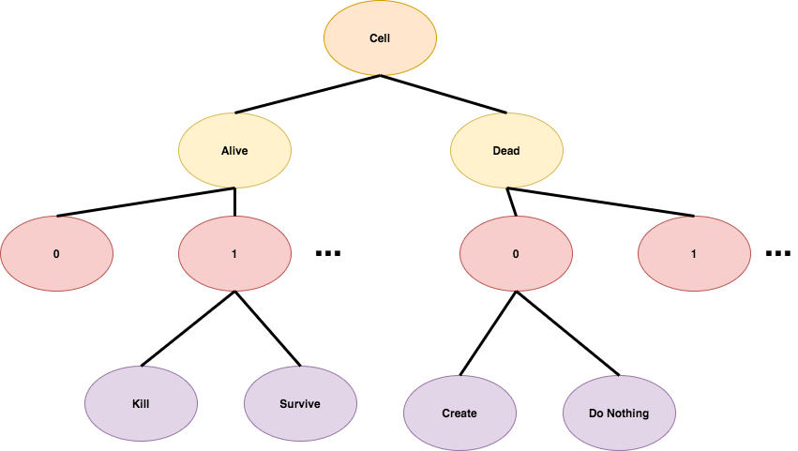
If the cell is ALIVE/DEAD, and is surrounded by # OF ALIVE CELLS, then CHANGE STATE
3 inputs per rule
4 rules total?
That would mean 12 attributes per individual

